Slide 1

Team ID: 30441
Team Name: Ghostpye
No. of Members: 6
Team Leader Name: Shantanu Nimkar
Problem Statement ID: RK1111

Slide 2
Details of all Team Members
SN | Team Member Name | Role | College Passing Year
1 | Shantanu Nimkar | Backend Developer(Python) | 2023
2 | Sameer Borkar | Android App Developer(React Native) | 2023
3 | Pawan Sharnagate | UI/UX | 2023
4 | Shraddha Shinde | Backend Developer(javascript) | 2023
5 | Sanyukta Khadilkar | Frontend Developer(HTML/CSS) | 2023
6 | Aditi Kamble | UI/UX , Frontend Developer | 2023

Slide 3
Idea Description (5 to 6 lines)
As we know floods occurs almost every year in our country and because of floods many lives get affected . so to solve/face these problems , so our idea is to build a mobile application which may give early food warnings to people using our app ,so that in mean time people can find safe places to take shelter .
As we know , in the time of flood it is not possible for the government to reach each and every part of flood affected area so with the help of this app, we can crowdsource the data from the flood affected areas. So that the government can analyze the data and make more precise decision at times of flood.
our app will also include features like SOS , help feature(user stuck in flood can use it to request for help) , message broadcast (G2C), etc

Slide 4
Innovative Idea Solution (50 Words)
The main highlights of application are :
1. As we know , in the time of flood it is not possible for the government to reach each and every part of flood affected area so with the help of this app, we can crowdsource the data from the flood affected
areas. So that the government can analyze the data and make more precise decision at times of flood.
2. User can request for help in case he/she is stuck in the floods.
3. Flood forecasting :Flood warnings, alerts are send to user before actual flood come to their location.
4. SOS (At time of Emergency, User can share their live location to their family,friends via sms service without INTERNET/OFFLINE. )
5. Message broadcasting G2C(Government to Consumers).
6.User can view upcoming 5 days flood forecast according to their location.

Slide 5
Reference Architecture / Solution Architecture (50 Words)
Our Application is mainly divided into two parts , mobile application and web-based application . Talking about mobile application it is build with React Native and backend is build using python , django rest , django , sqlite . With web-based app government authority can monitor all the activities that are going in mobile application . for more information you can refer architecture diagram on slide no 9 .

Slide 6
Technology Stack
BACKEND :
Python , Django , Django Rest Framework , JWT(Json Web Token), Heroku
FRONTEND :
React , React Native , JavaScript , Expo

Slide 7
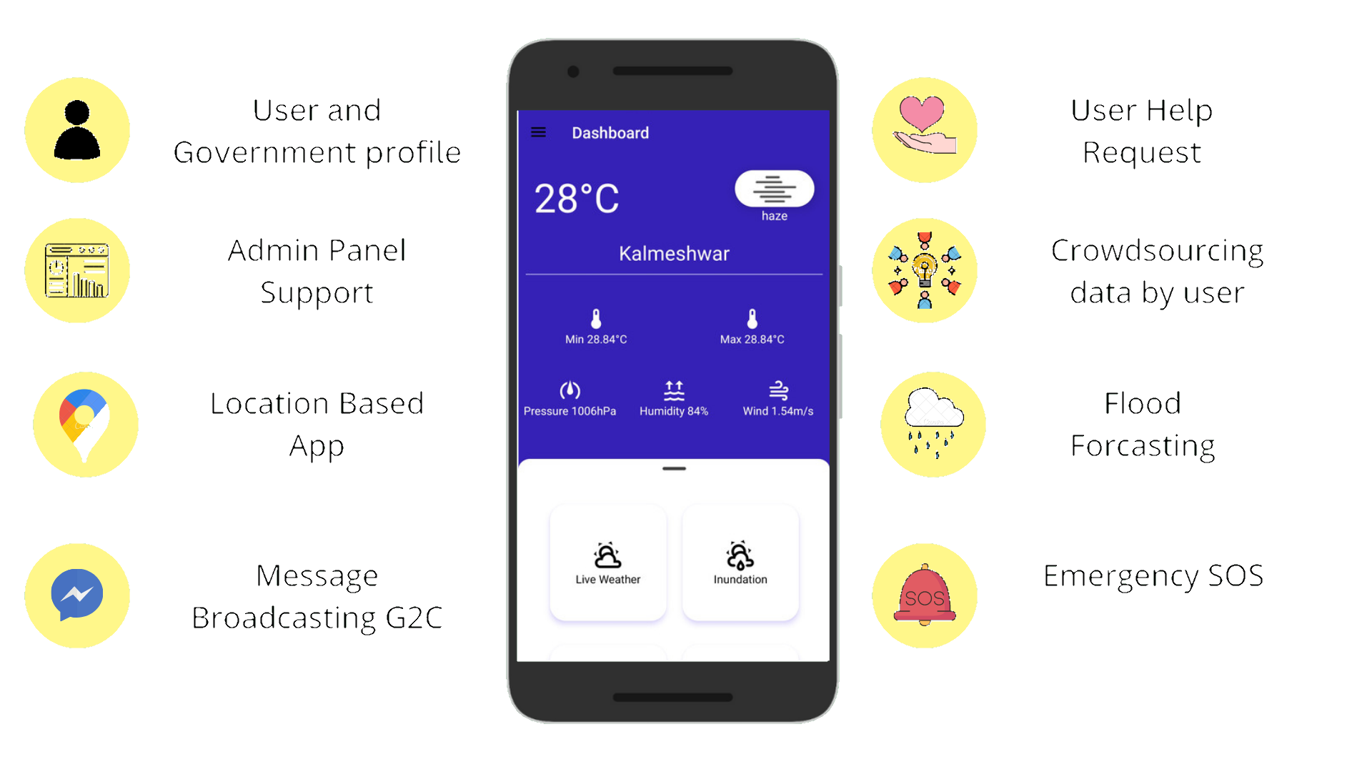
FEATURES

Slide 8
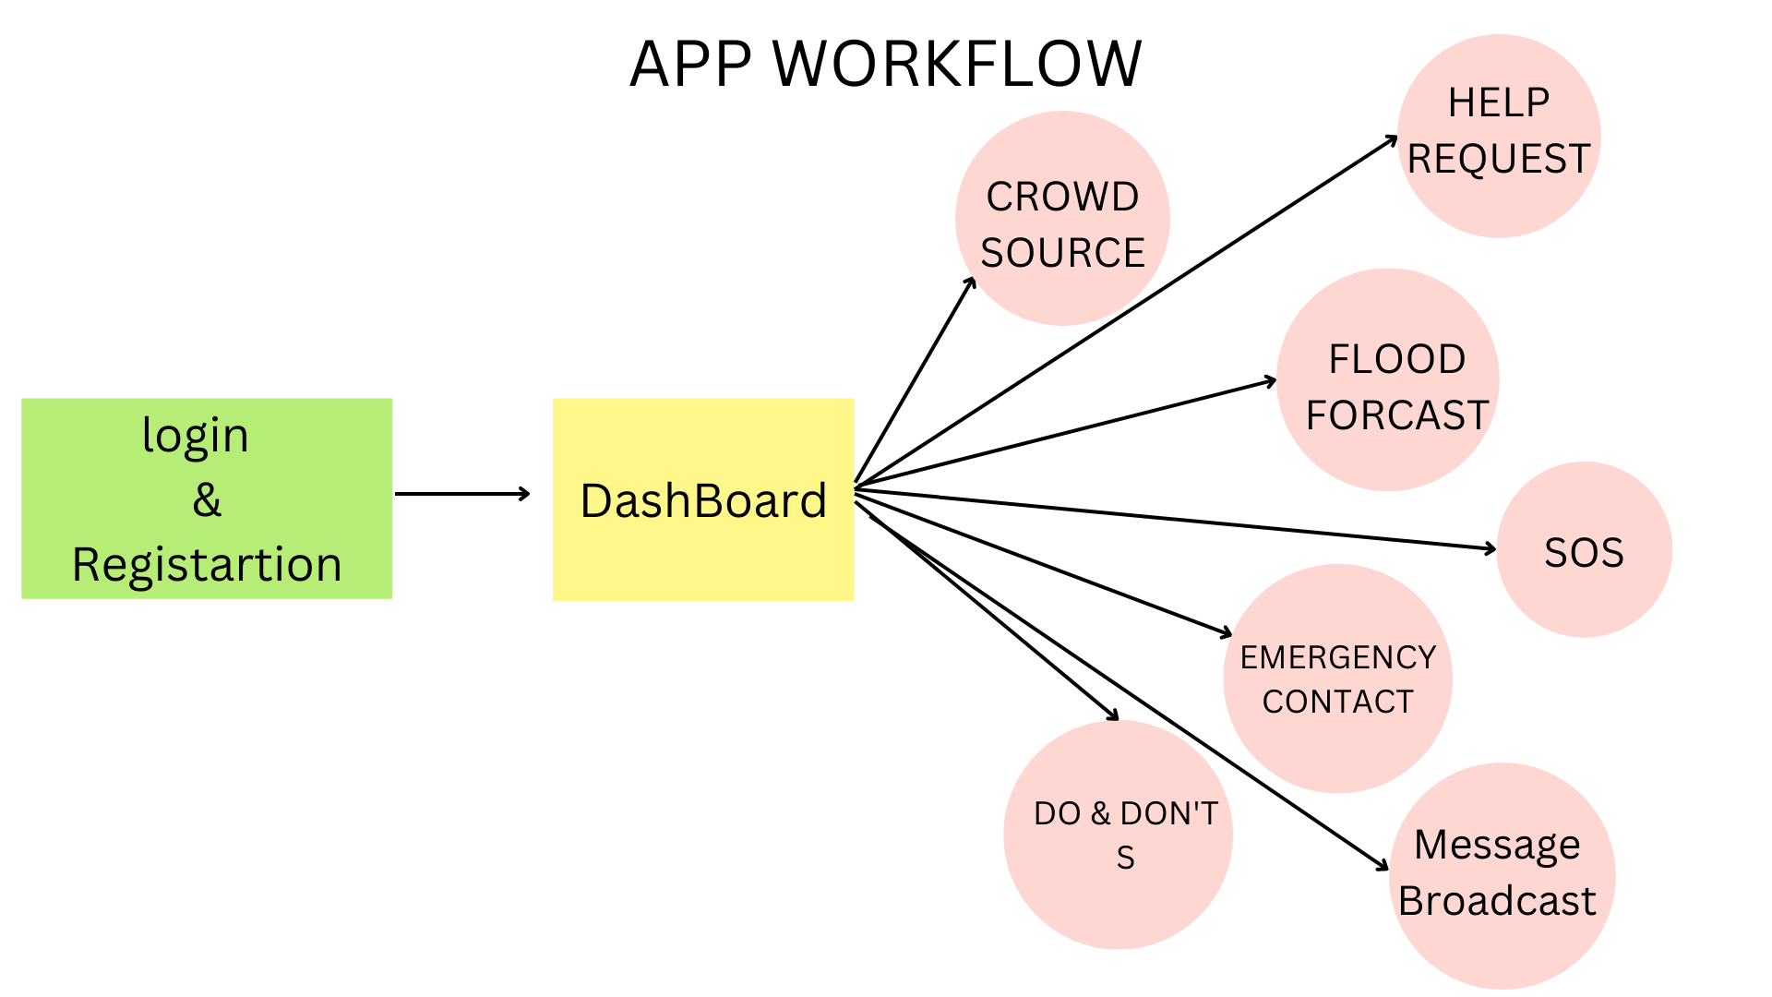
Images / Screenshots of the working prototype

Slide 9
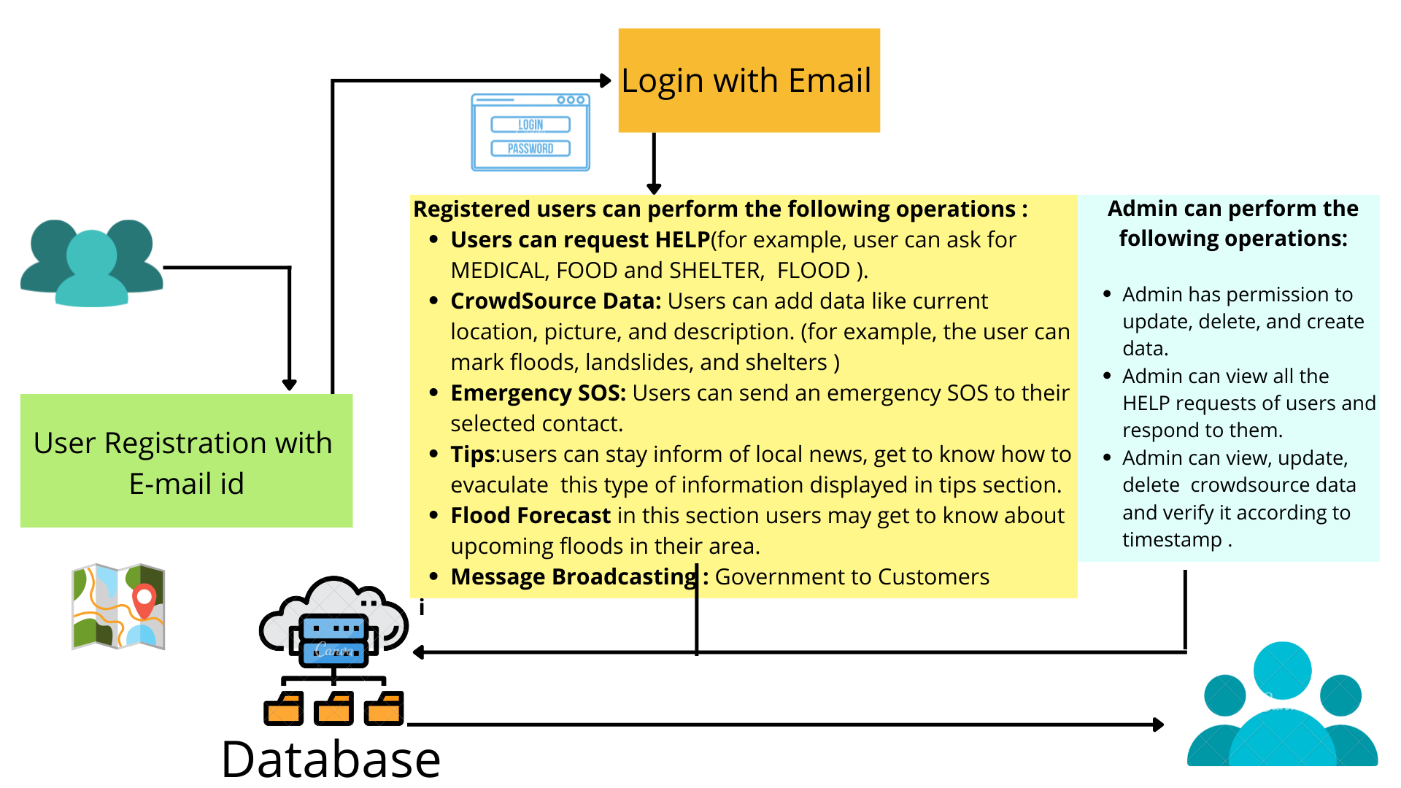

Slide 10
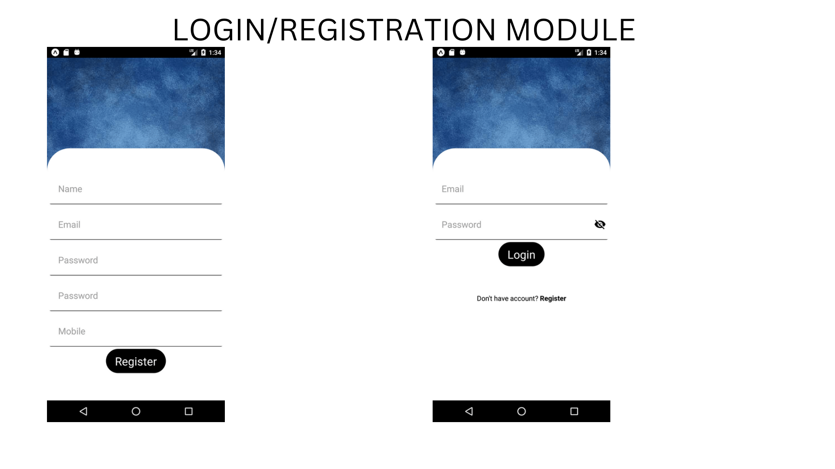

Slide 11
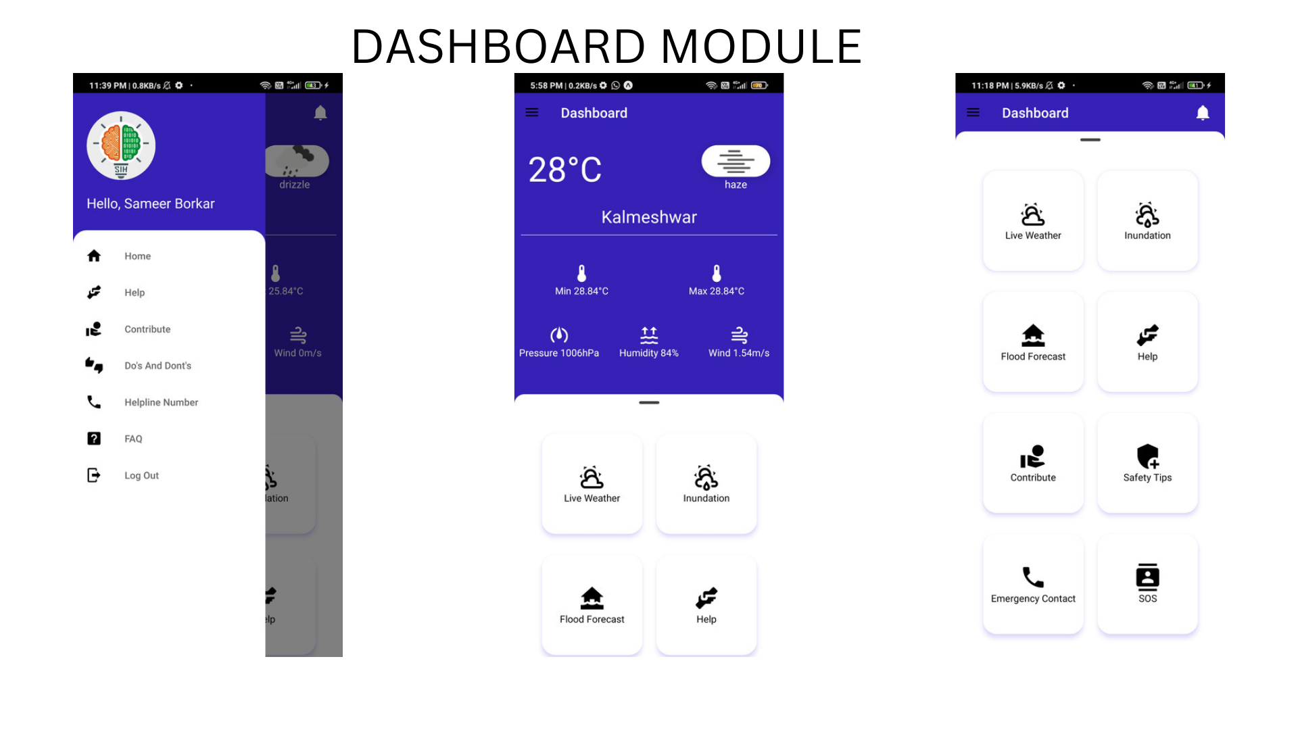

Slide 12
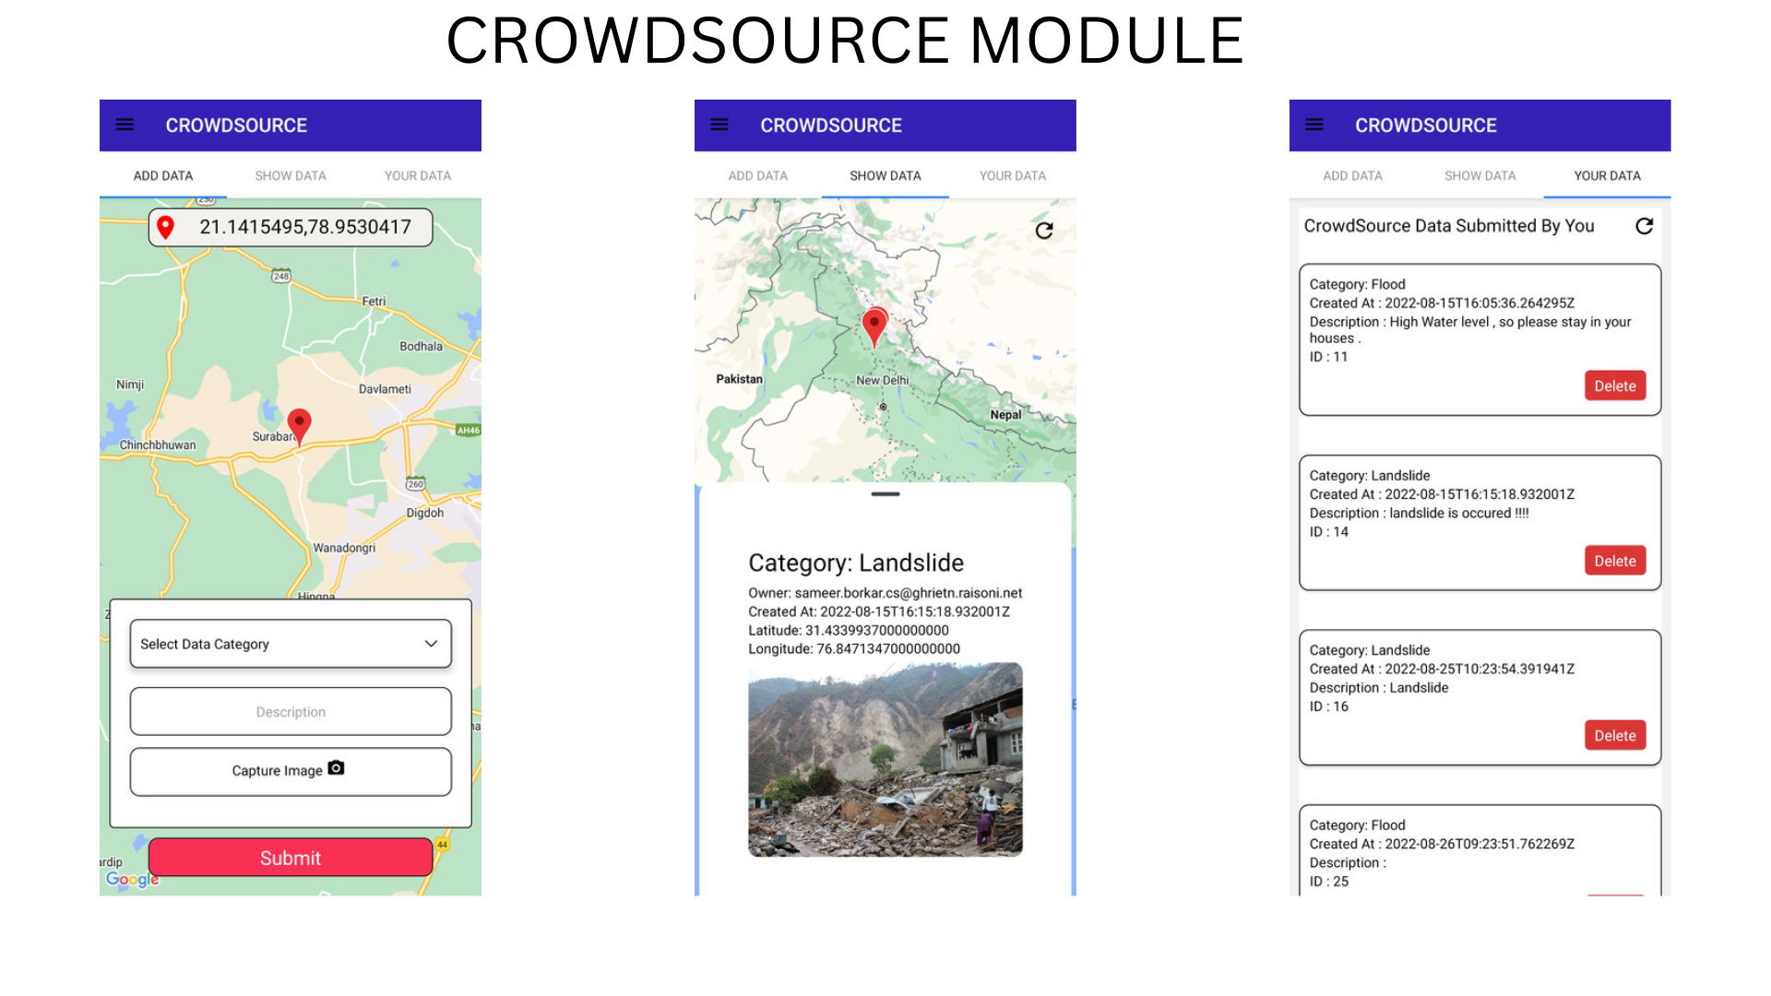

Slide 13
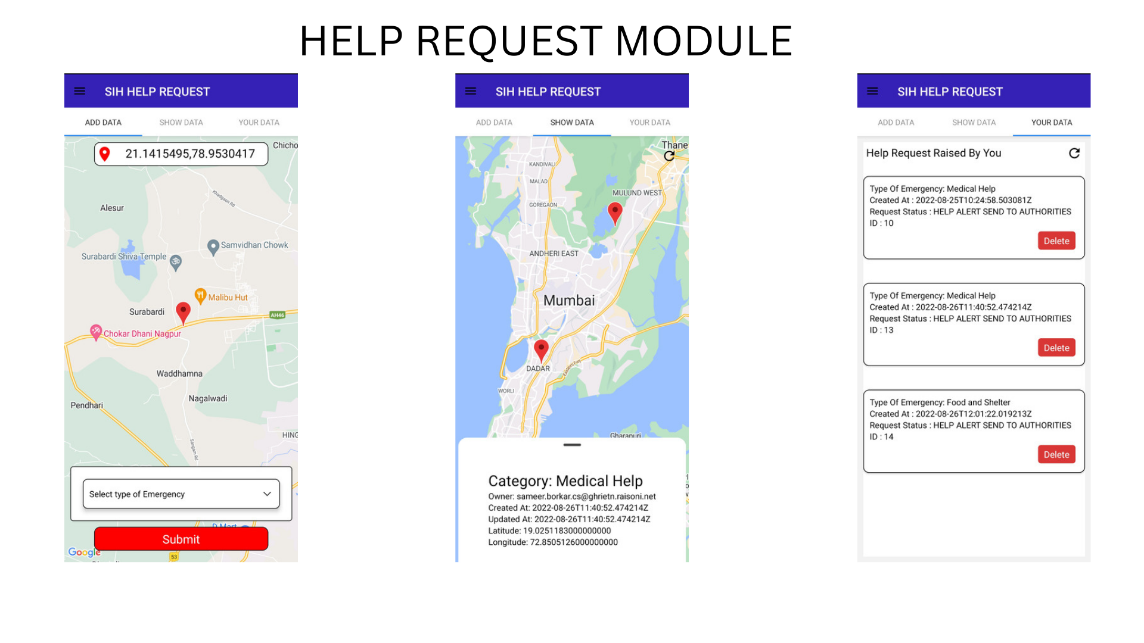

Slide 14
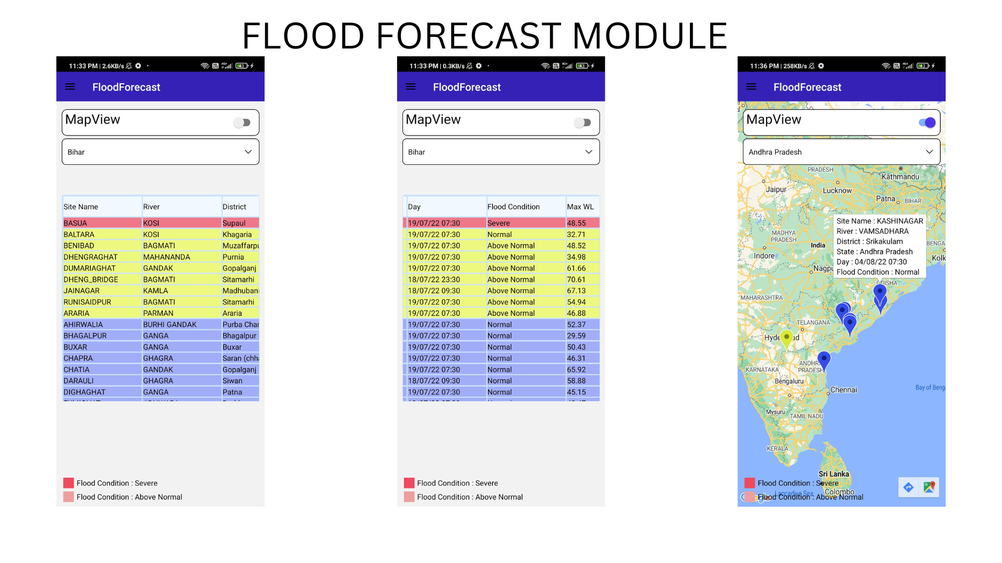

Slide 15
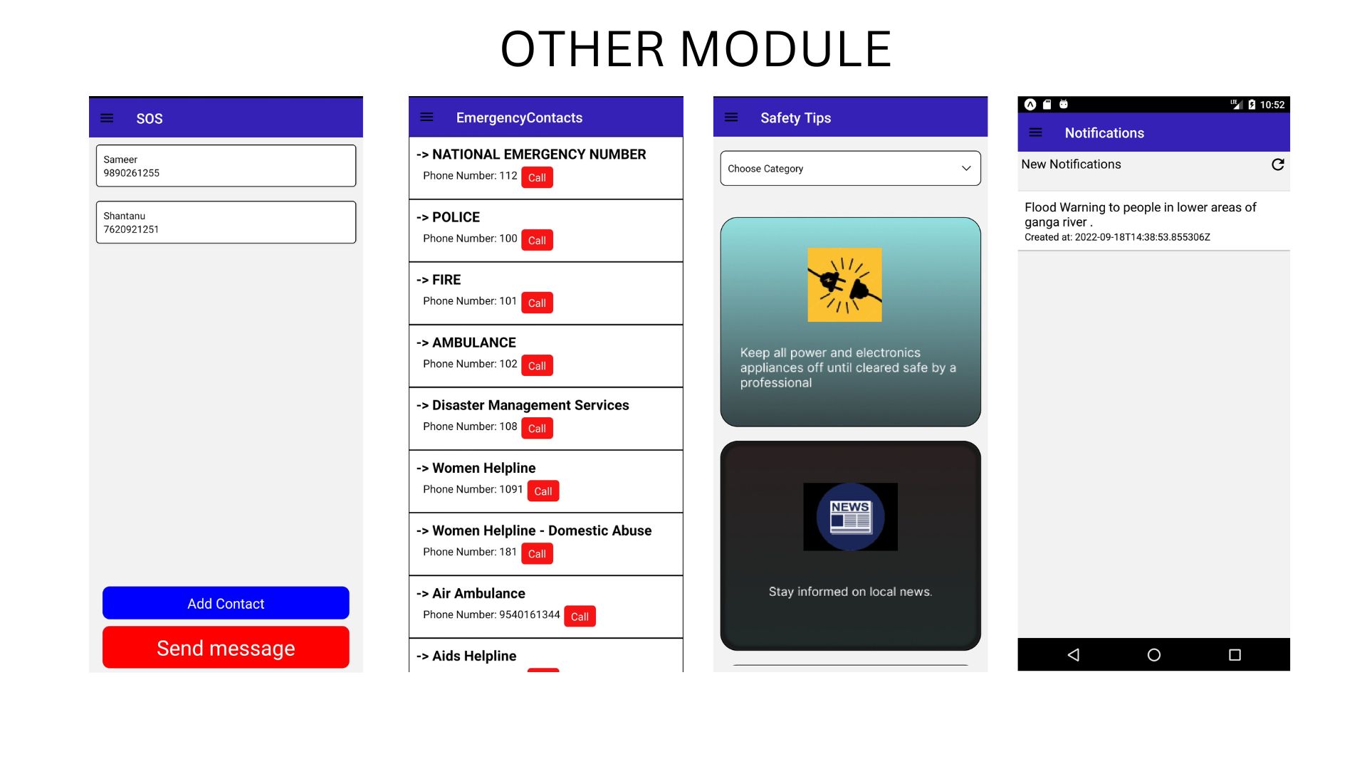

Slide 16
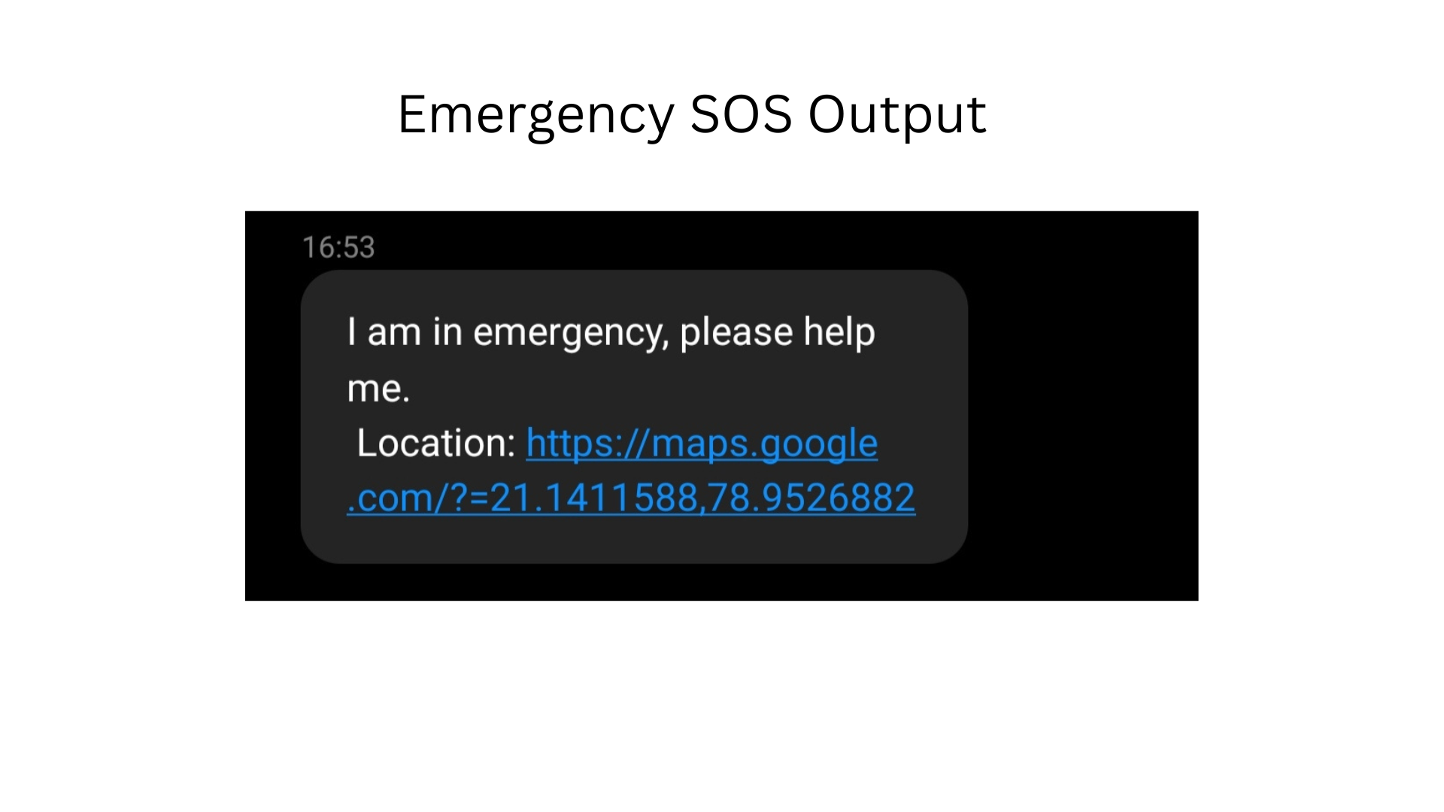

Slide 17
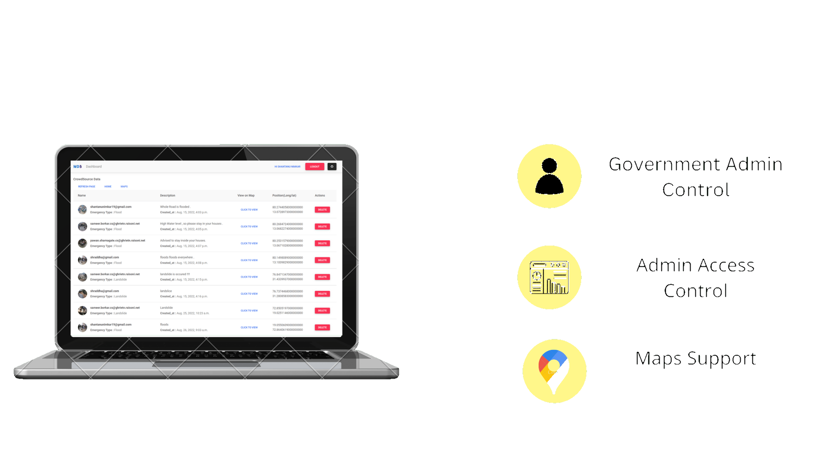
FEATURES OF WEBAPP

Slide 18
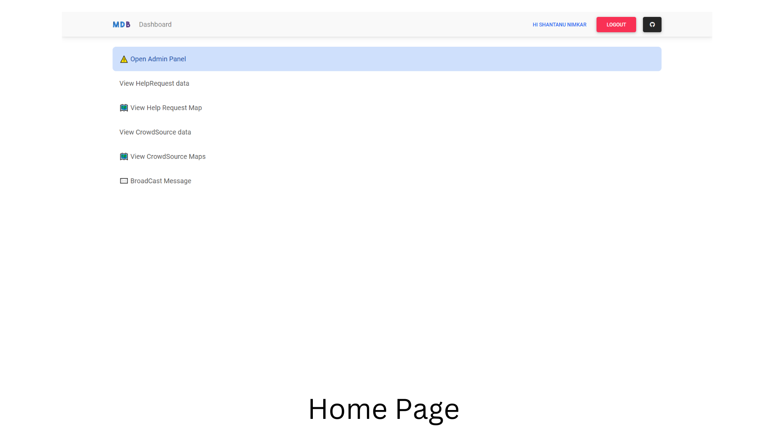

Slide 19
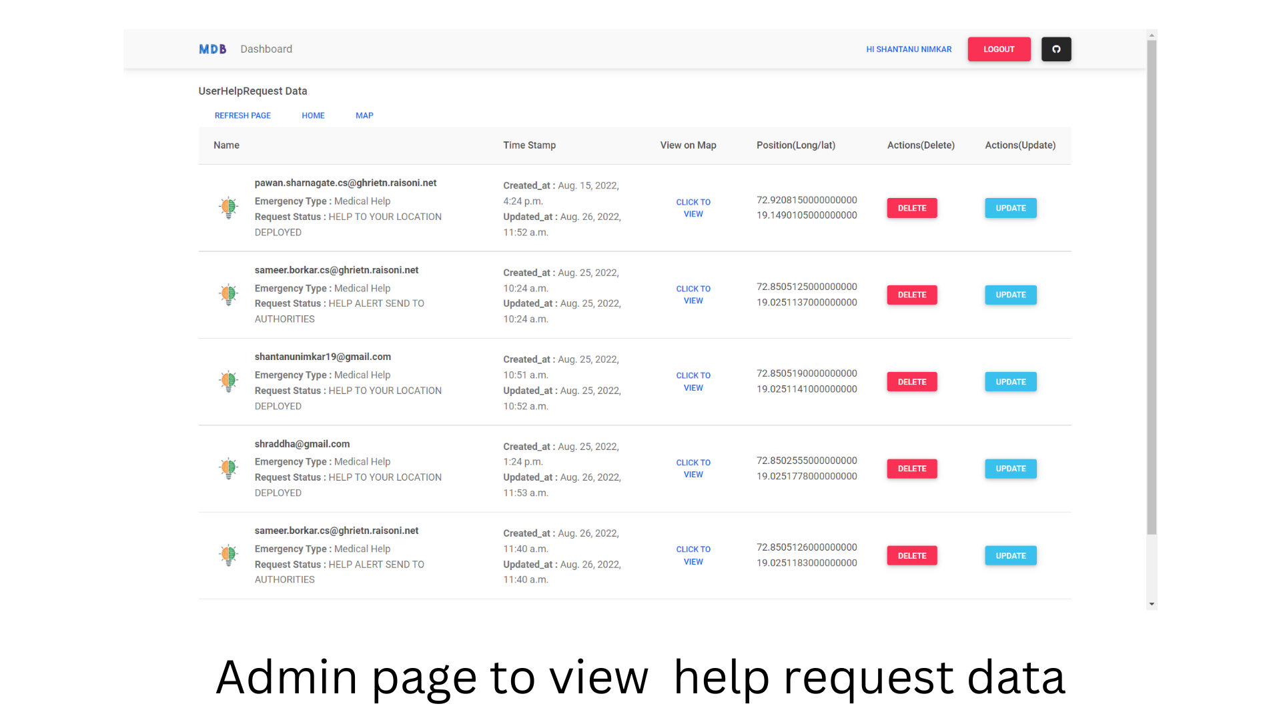

Slide 20
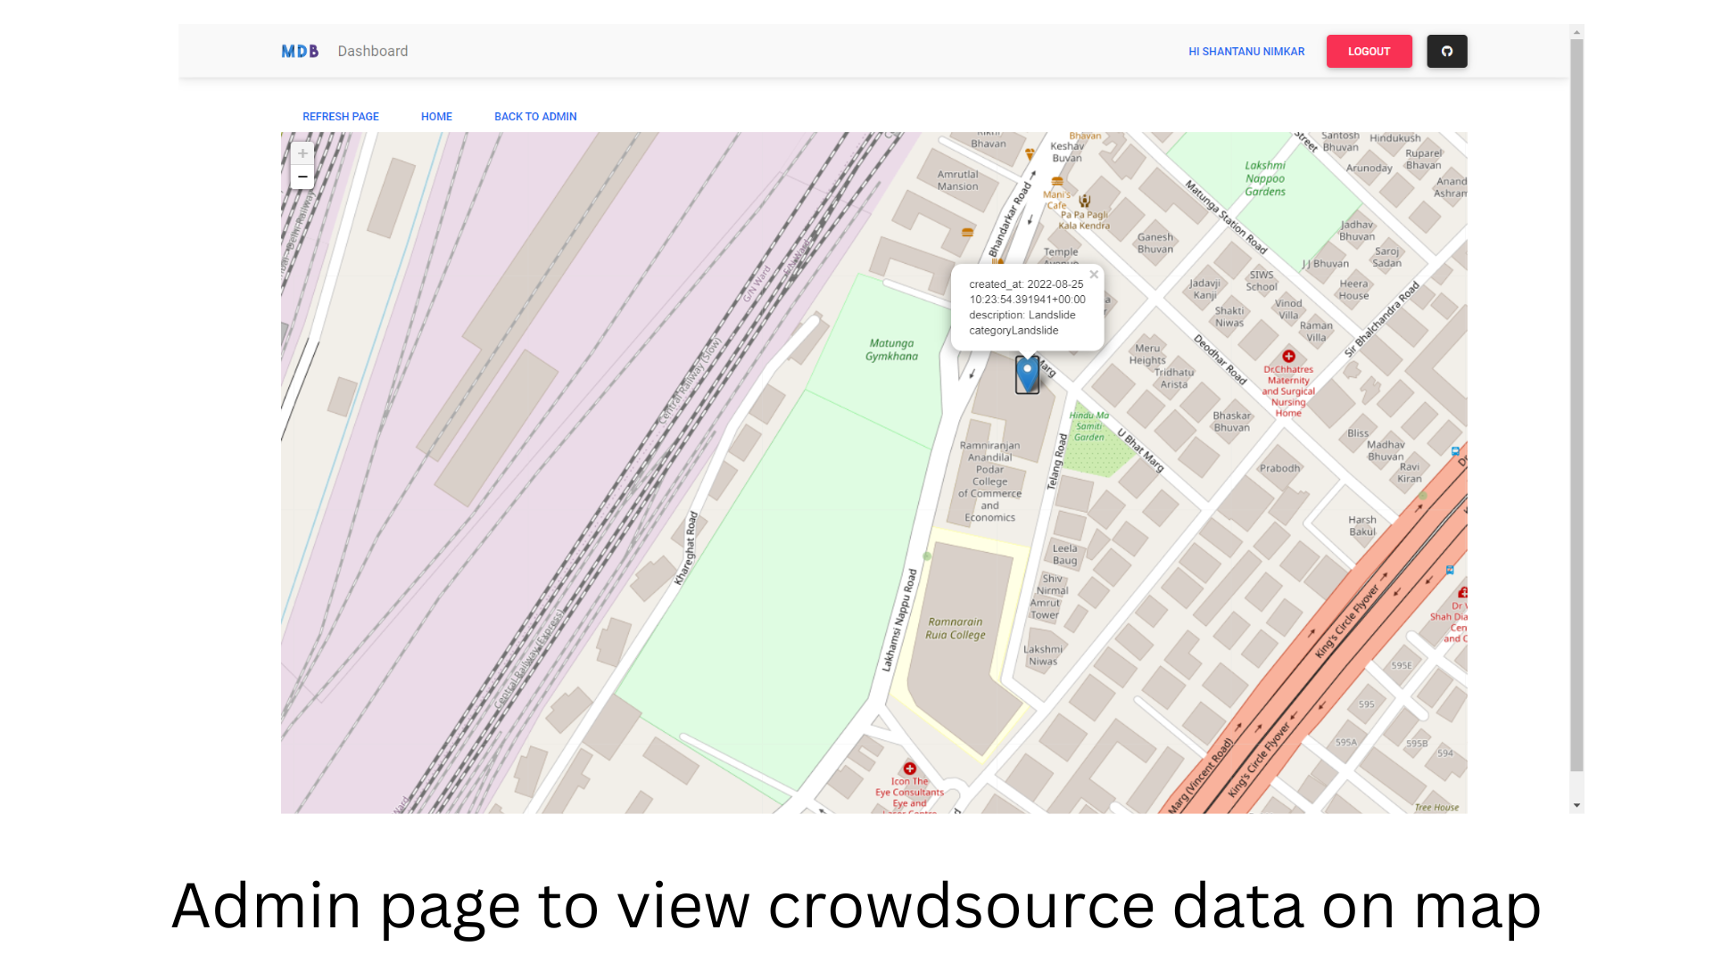
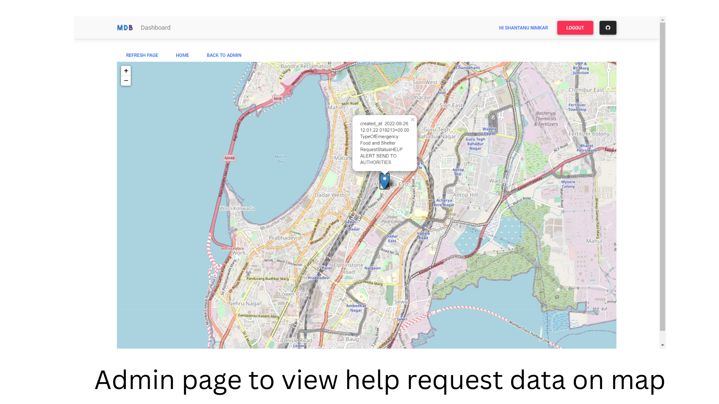

Slide 21
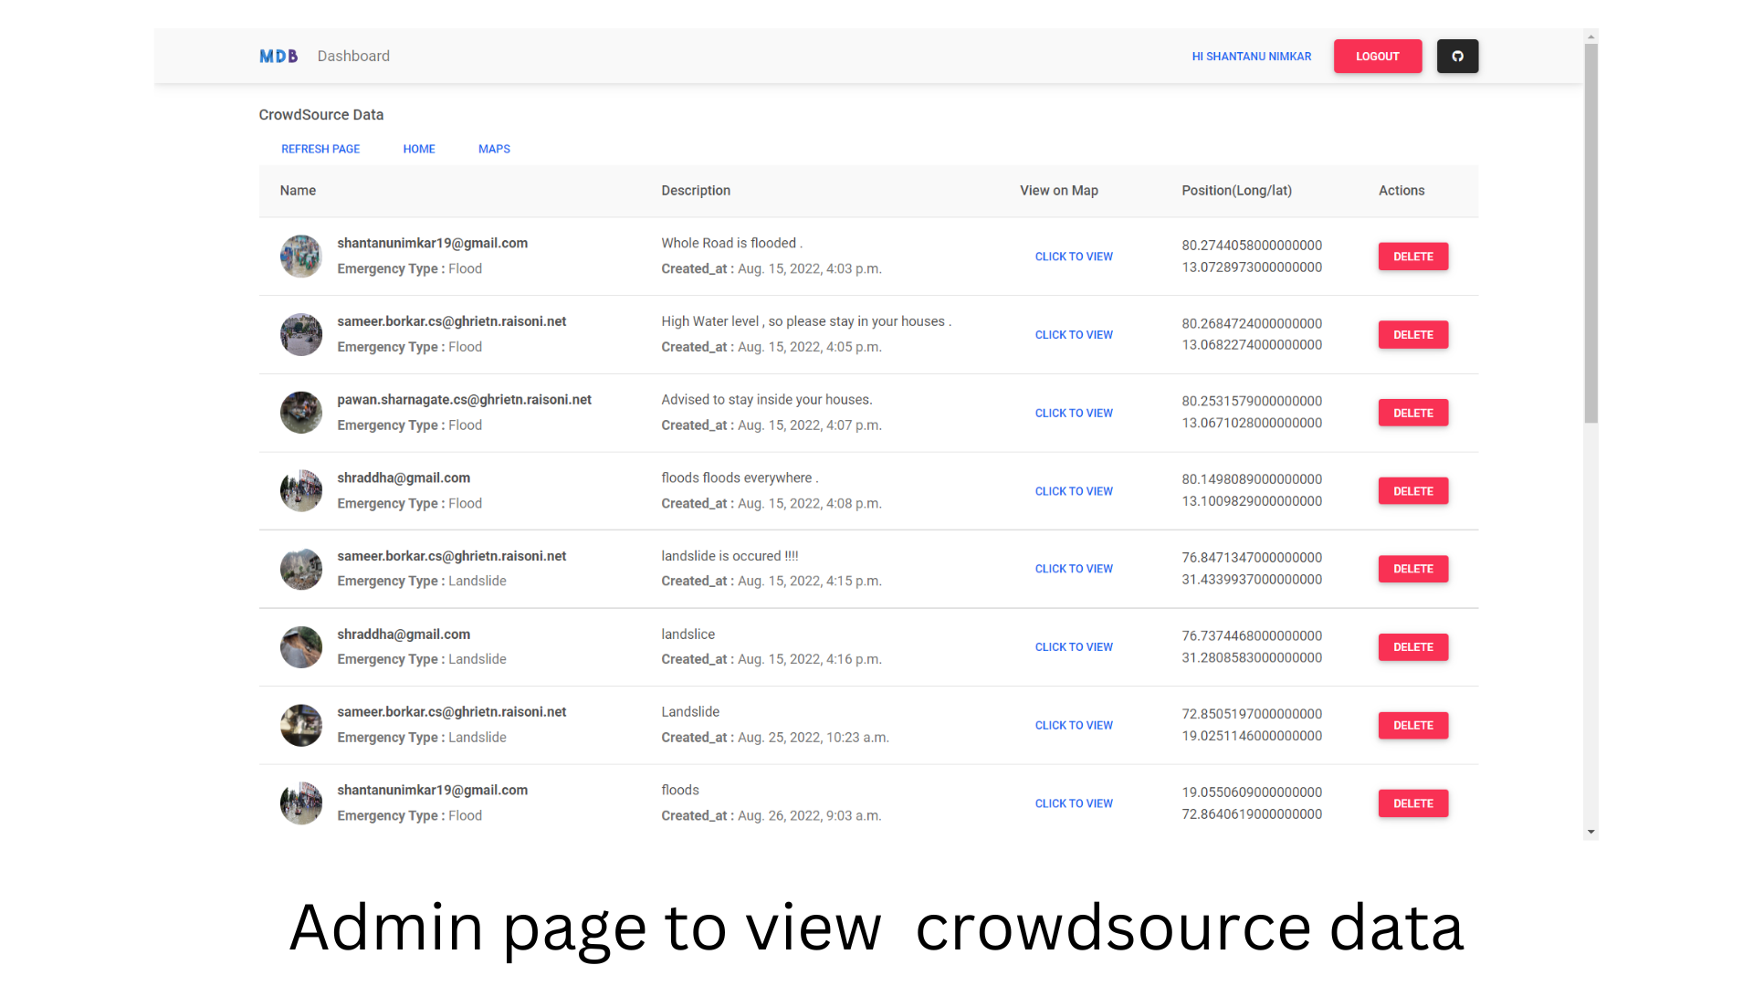

Slide 23
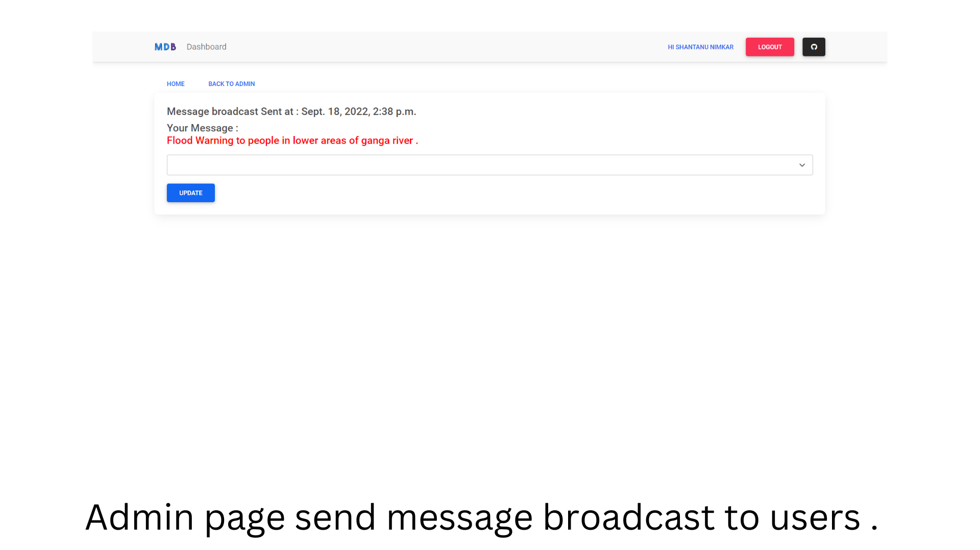

Slide 24
Video of Working Prototype (High resolution - <1min)
click the link given below to view prototype working video
https://drive.google.com/drive/folders/1GRRGTGo1cii0DC2ofrtg5PG6xHQsmF47?usp=sharing

Slide 25
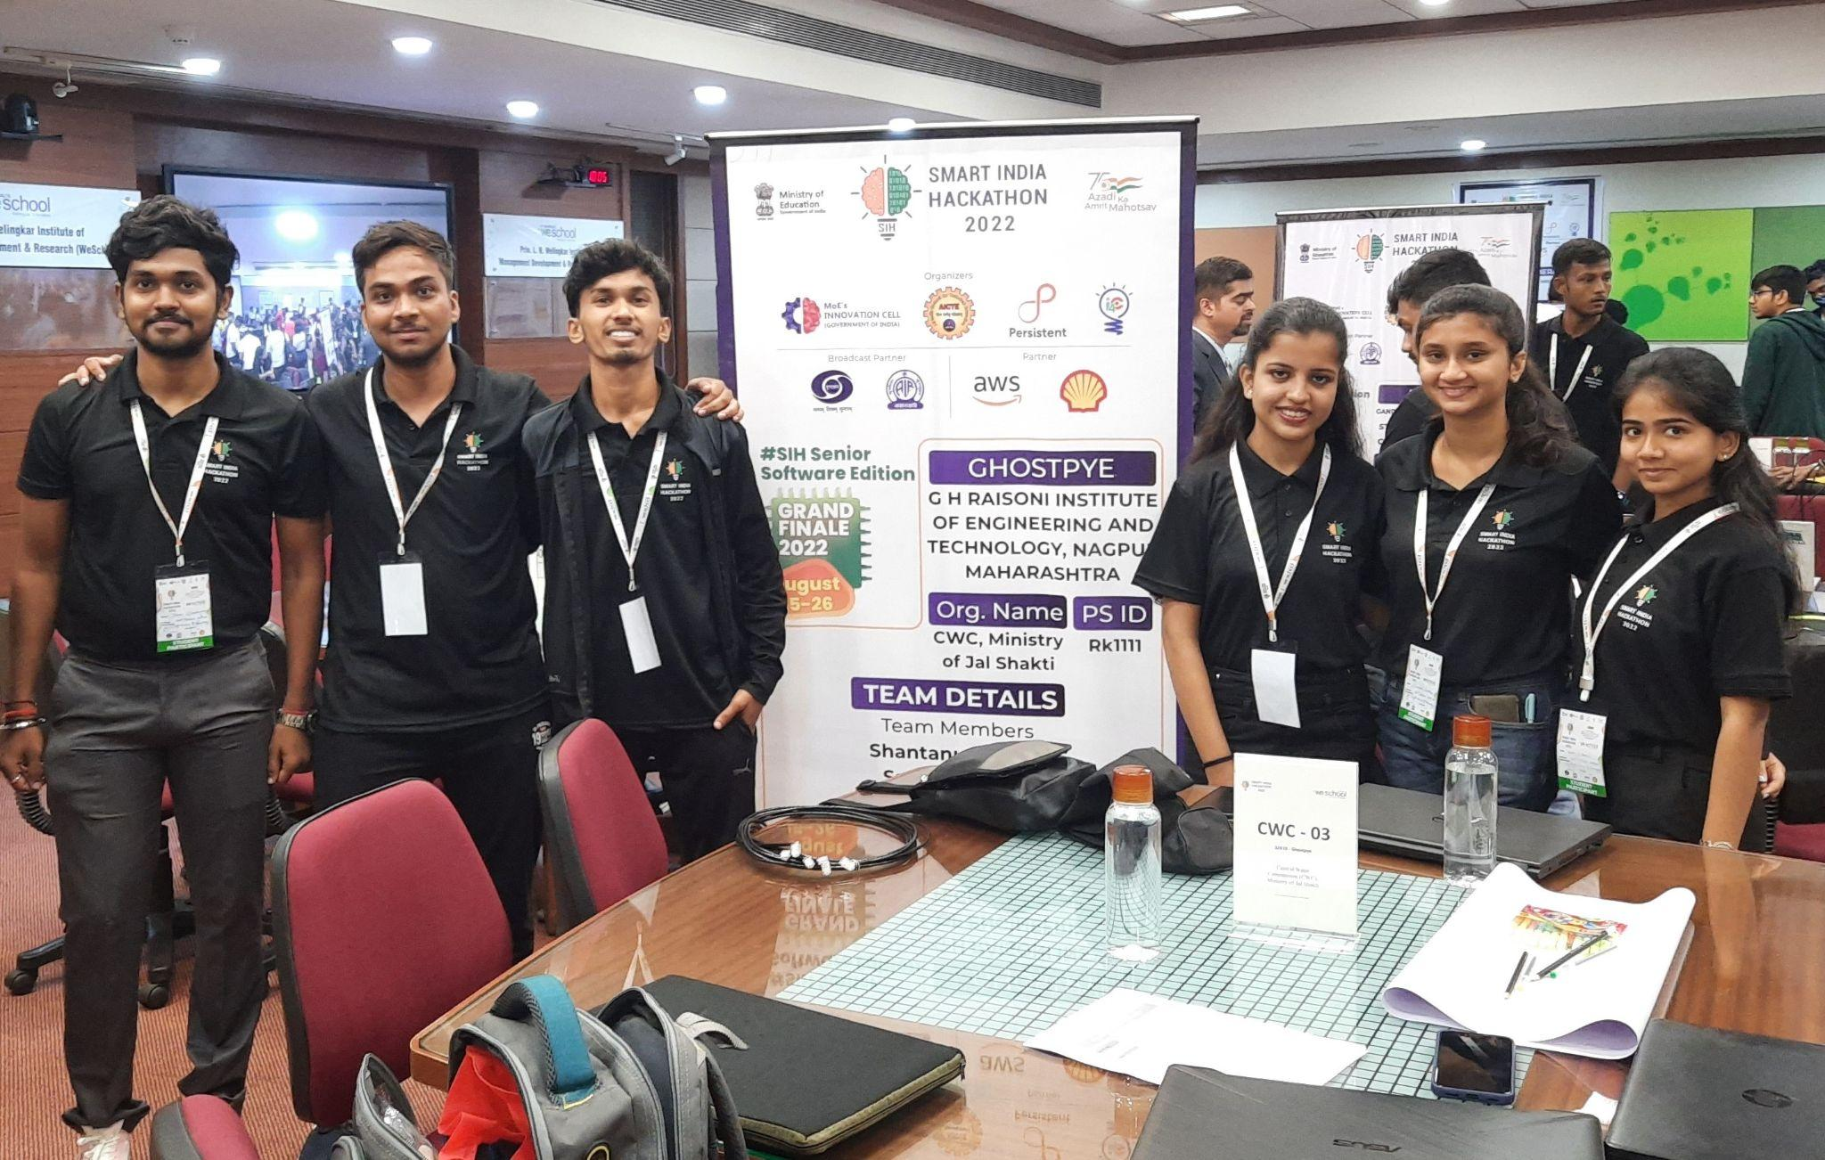
Group Picture of all Participants with Developed Prototype (High Resolution)

